Slide 1


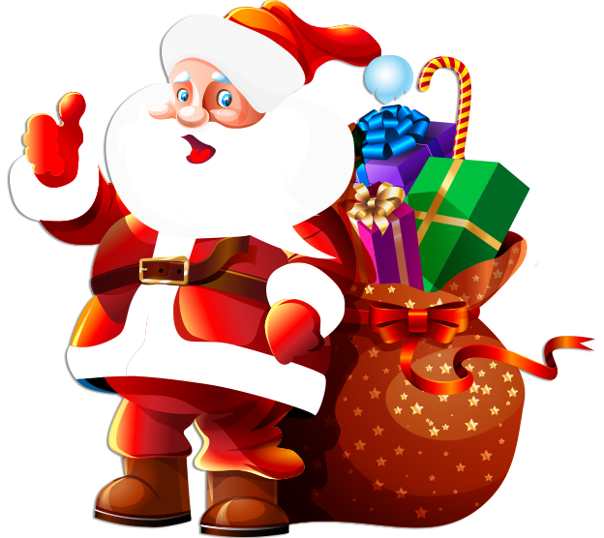

HOLIDAYS;
Christmas

Slide 2






Write down any Christmas words you already know or create them on: https://wordart.com/ by selecting CREATE NOW!
presents
reindeer
Santa
CHRISTMAS
Practice here: https://wordwall.net/resource/8715884
When do we celebrate Christmas?

Slide 3
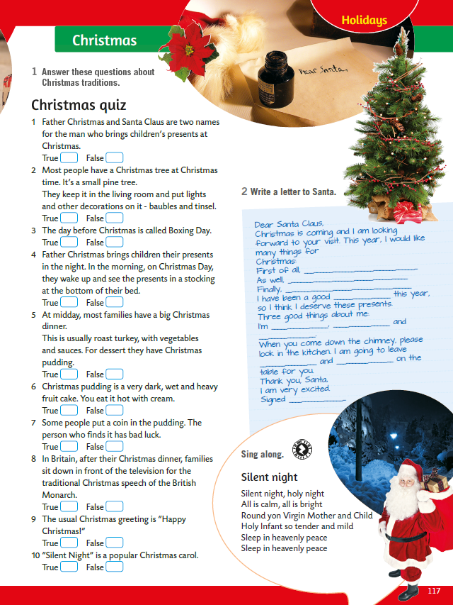
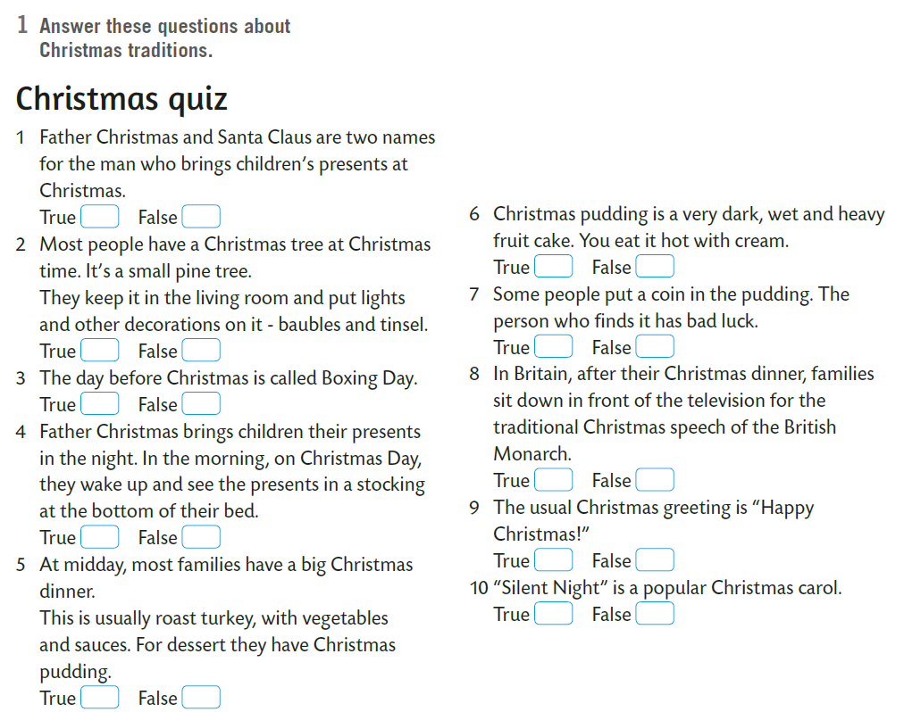

Open your book, page 117.
Answer these questions about Christmas traditions.
Označi jesu li izjave o božićnim tradicijama točne ili netočne.
Ovaj zadatak možeš riješiti i u digitalnom obliku na sljedećoj poveznici:
https://wordwall.net/resource/8722604
Poslušaj zvučni zapis i provjeri jesi li bio u pravu!

Slide 4

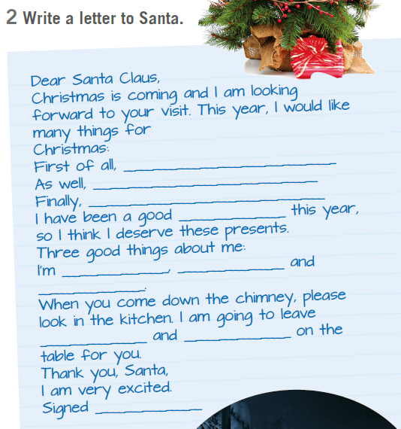
What would you like to get for Christmas?
Write a letter to Santa.

Slide 5

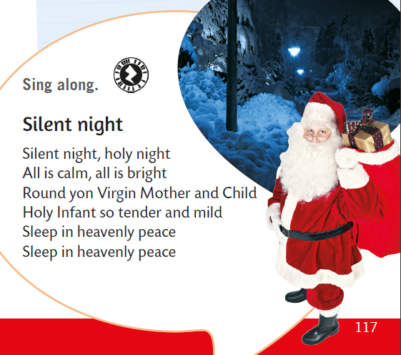
Look at the lyrics of the carol Silent Night. Do you recognise the song?
Listen to the song and join in singing.
https://www.e-sfera.hr/dodatni-digitalni-sadrzaji/9ce447cf-ed10-42aa-8633-f312dba54bc9/assets/audio/48_holidays_-_silent_night.mp3

